Slide 1
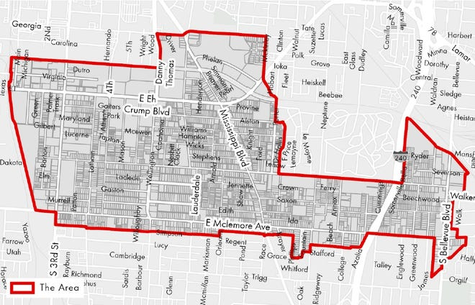


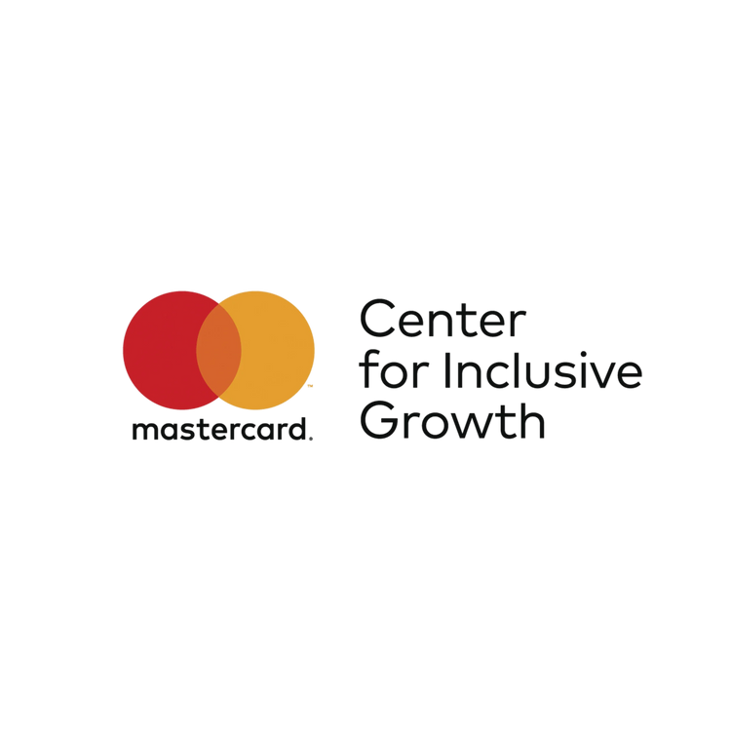

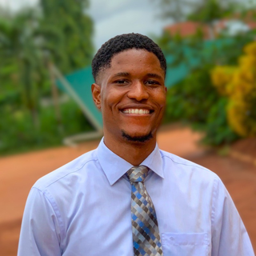
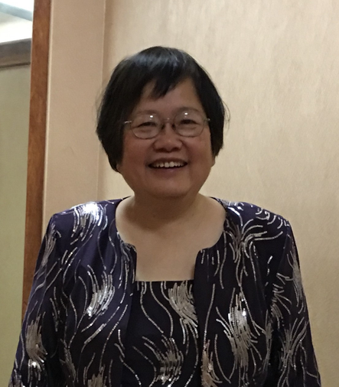
South Memphis
Increasing the Inclusive Growth Score of South Memphis through Addressing Capital Access Disparities​
TEAM AURA
Biynah Dayok
Chisom Okonkwo
Dr. Valerie Chu

Slide 2
Problem Statement:
Majority-Black neighborhoods in Memphis received over 5.8 times less investment per person than majority-white areas, stifling the flow of capital that could power business growth and opportunity in South Memphis.
Source: Urban Institute. (2020). Community development finance in Memphis. Urban Institute. https://www.urban.org/sites/default/files/publication/104511/community-development-finance-in-memphis_0.pdf

Slide 3






Community Overview:
South Memphis Profile:
Zero tax wages
Major corporate anchors
Growing startup ecosystem
112+ top startups (MiCare Path, SecondKeys, MyBambu)
Strong sense of community and resilience
Home of Soulsville and Stax Museum
Poverty Rate: 47.7%
Population: 2,184
Children in Poverty: 23.5%
Race: ~90% Black
Unemployment: 4.7%
Median Income: $28,057

Slide 4
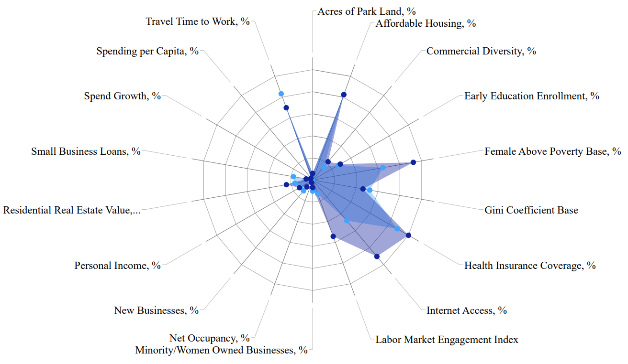
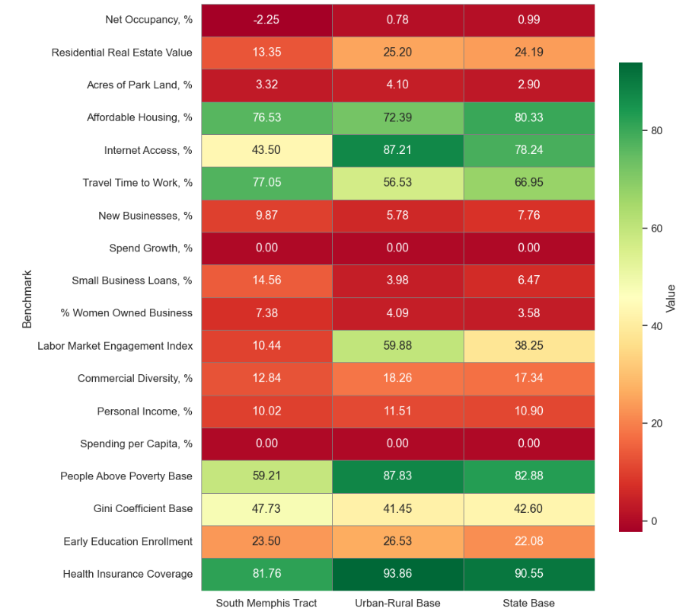
BENCHMARK
BENCHMARK SOUTH MEMPHIS TO USA BASE
South Memphis higher than the benchmark in: Women Businesses, Business Loans, New Businesses
BENCHMARK SOUTH MEMPHIS TO STATE AND URBAN RURAL BASE

Slide 5
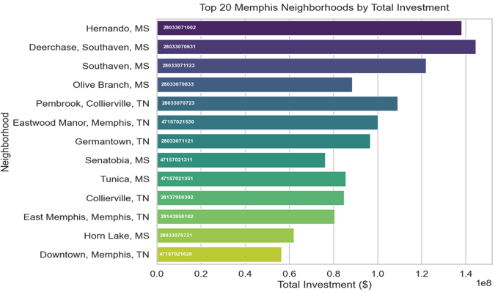




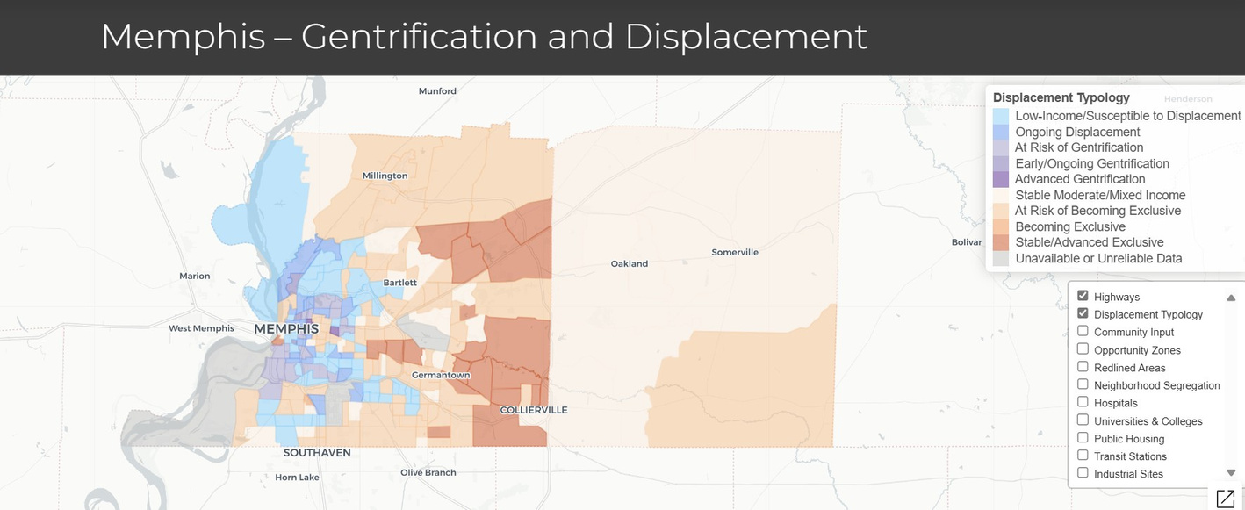
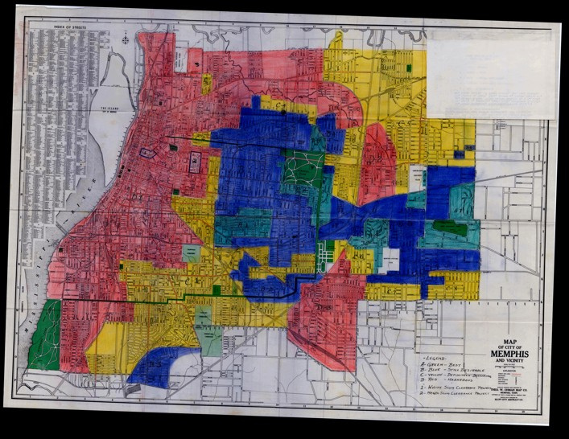
Key Findings:
~10.6 bankruptcies per 1,000 residents​
Median Income: $28,057​
Community Investment Explorer(CIE) Funding Per Capita
All Tracts (National Median) ​
$251.28
Memphis Tracts (Median)​
$1,299.08
Poverty Rate: ~22.6%​
URBAN DISPLACEMENT PROJECT TOOL
RICHMOND REDLINING TOOL

Slide 6



Proposed Solution:
Setup a Community Development Financial Institutions Fund (CDFI)
South Memphis Community Investment Fund (SMCIF) is a new nonprofit CDFI to help provide affordable loans and financial education. South Memphis residents and small businesses. (Goal: raise $5M)
Run by South Memphis Renewal Community Development Center (SMRCDC)
The CDFI will get money through grants, donations, and loan capital from funders, banks, and community investors.
Leverage an equity-focused machine learning model to assess creditworthiness and lending capacity,

Slide 7
Implementation Plan & Timeline
Phase 1:
Foundations
Phase 2:
Operational Setup
Phase 3:
Pilot Lending
Phase 4:
Expansion
Phase 5:
Scaling
Form 501(c)(3)
Establish Board
Secure early partners and seed fundin
Set lending and compliance policies
Hire core staff
Implement loan software
Launch outreach
Begin building fair-lending ML model
Launch microloan pilot
Deliver financial literacy sessions
Test ML model
Monitor early loan performance
Add new loan products
Integrate ML into underwriting host small-business summit
Grow loan capital
Build lending track record
Prepare CDFI certification
Expand outreach and loan volume
Months 1–3
Months 4–6
Months 7–12
Months 13–18
Months 19–24
Source: Interview with Founder of South Memphis Renewal Community Development Center and The HBCU Coalition

Slide 8
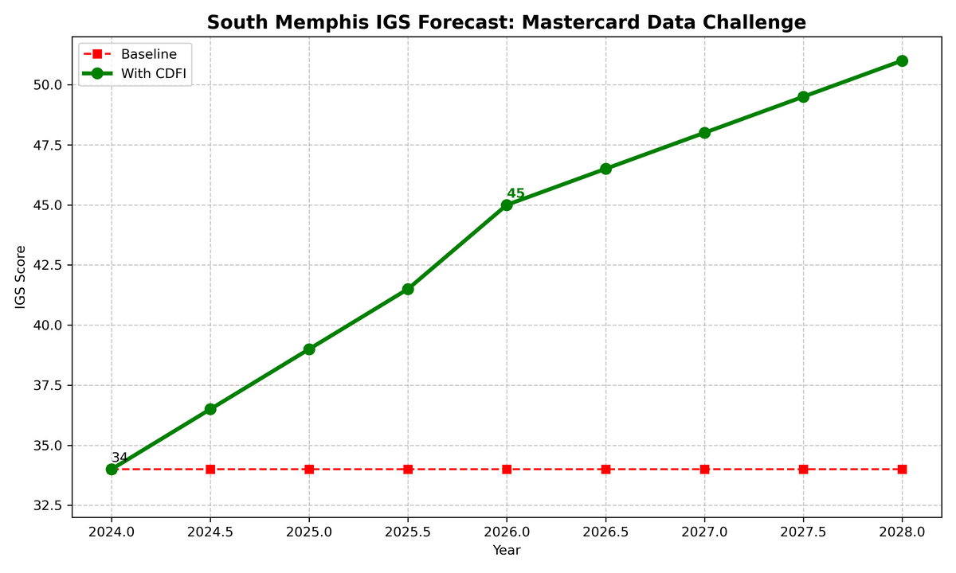
Predicted Outcomes
Forecast Summary​:
IGS rises from 34 (2024) → 45 (2026) +11 point gain via +20% Small Business Loans Growth​
Why This Works​:
+20% Loan Growth = +15 Economy Points ​
~20% increase in approvals → 15–25% rise in minority business revenue (SBA 2025 Report). ​
~IGS shows 1% loan growth ≈ +1.2 Economy points.​
​
Gini Drops by 0.1 ( +10 Community Points )​
Census ACS: 10% poverty reduction ​
IGS: 0.1 drop in Gini metric = 8 to 12 Community Inclusion points (pillar weighting).​
​
Historical Baseline Drop: -0.5 pts/year ​
IGS Tool: Average annual change = -0.5 (tract declining). ​
Intervention reverses trend + adds boost = +11 net.​

Slide 9
Metrics For Success
How We Track & Refine — Every 3 Months Quarterly check-ins: pause, reflect, adjust. Data shows 85% of successful programs review quarterly
(Urban Institute 2023).
Metric | Now (2024) | Target (2026) | How We Track | Source
IGS Score | 34 | 45 | Annual IGS update (Jan) | IGS Platform
Loans Growth | -12% | +8% | Quarterly SBA reports | SBA + IGS Platform
Black-Owned Firms | 7.3% | 15% | Annual business census | Heartland Forward 2023
Poverty Rate | 52% | 40% | Annual ACS release | Census ACS
Loan Approvals | 55% denied | 25% denied | Quarterly program data | Internal + LendingTree
Time | What We Do | Why It Works
Q1 | Review first 100 loan apps | 78% of CDFI programs adjust after Q1 (SBA 2025)
Q2 | Survey 50 residents | Feedback fixes 60% of issues early (Urban Institute)
Q3 | Compare IGS mid-year | Early signals → 90% on track by Year 2
Q4 | Full report + refine ML model | Data loop closes — proven in 80% of AI credit pilots
When things go off track, stop, reassess, and adjust course.

Slide 10
Conclusion:
1. Current Challenges in South Memphis: IG S 34, 52% poverty, $13,646 median income (IGS 2024, U.S. Census ACS 2023).
2. Root Cause: Unequal Access to Capital -12% Small Business Loans Growth and 45% denial rates for Black-owned firms (IGS Platform 2024, LendingTree 2024).
3. Solution: CDFI capital program delivers (+20% loan growth) + ML-powered credit scoring (SBA 2025, Census ACS model).

